Slide 1
Advanced Clustering
http://bit.ly/2lQvtJC Pin 160919

Slide 2
1) Intro
2) Hierarchical Clustering
3) Density-Based Clustering
What is clustering and why is a KNN not always best?
What are agglomerative and divisive algorithms?
What are density based clustering algorithms?

Slide 3
Use Cases?
Do you know any?

Slide 4
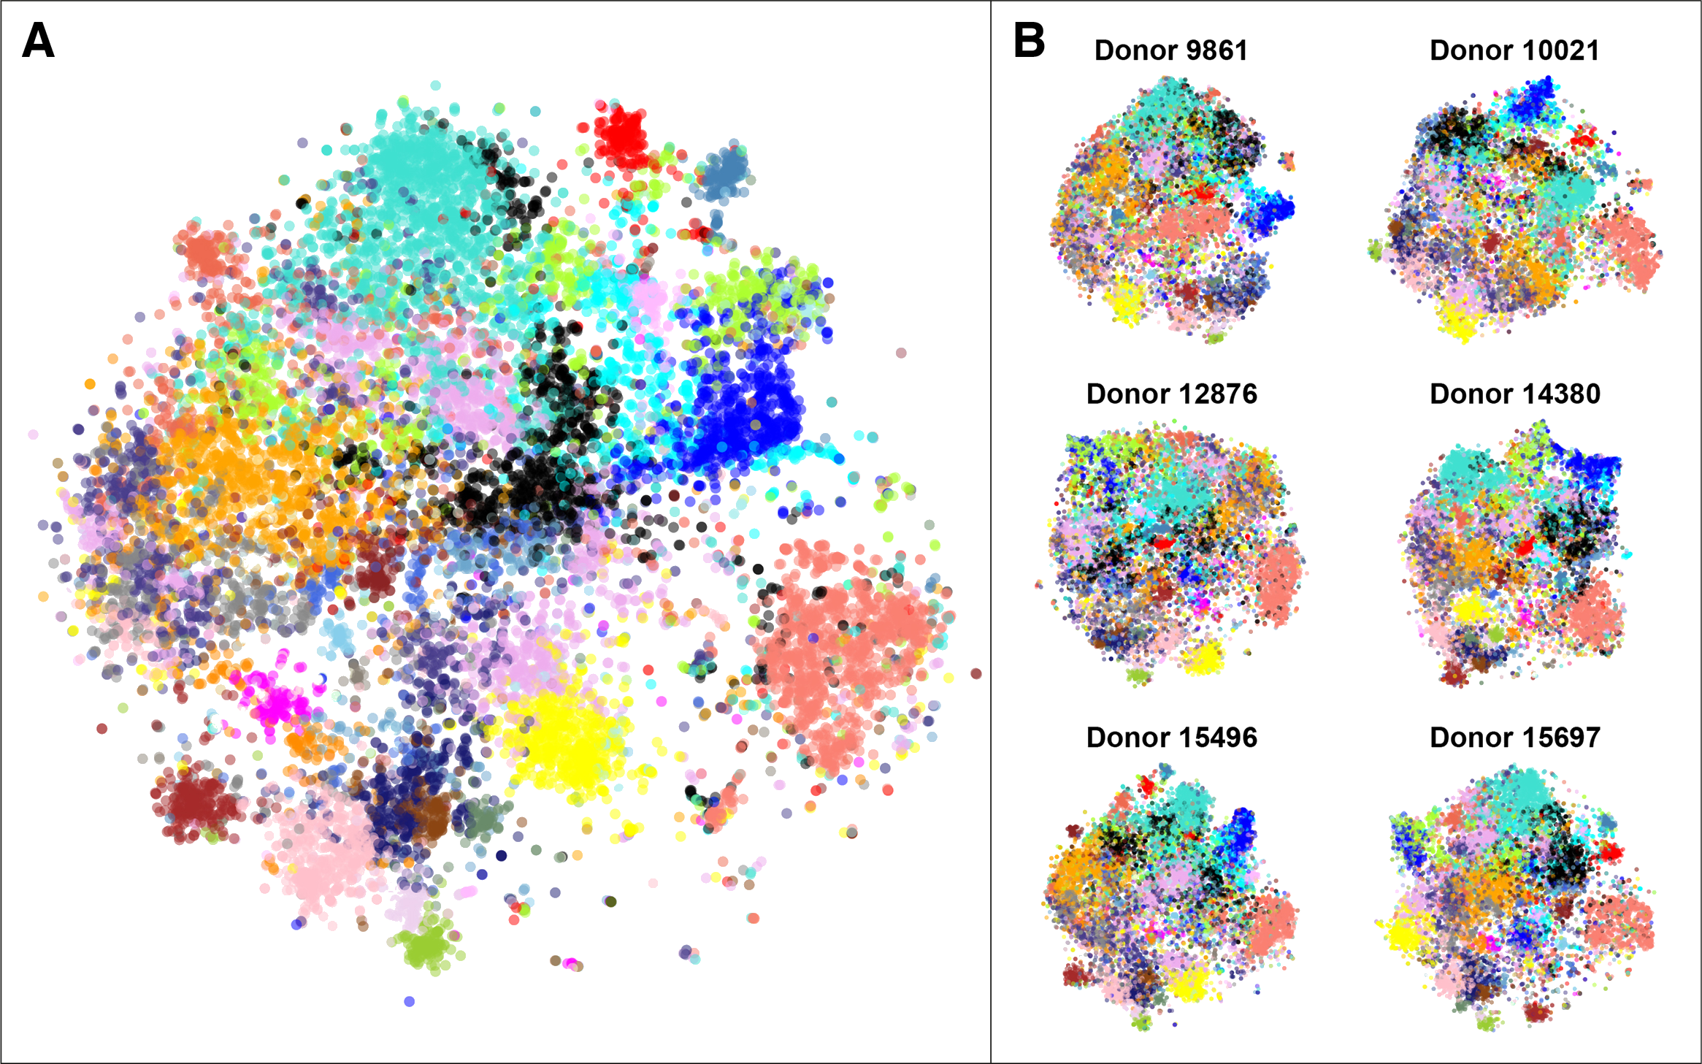
Neuro Use-Case Example
Gene-expression clustering in humans
Sjoerd M.H. Huisman, Baldur van Lew, Ahmed Mahfouz, Nicola Pezzotti, Thomas Höllt, Lieke Michielsen, Anna Vilanova, Marcel J.T. Reinders, Boudewijn P.F. Lelieveldt, BrainScope: interactive visual exploration of the spatial and temporal human brain transcriptome, Nucleic Acids Research, Volume 45, Issue 10, 2 June 2017, Page e83, https://doi.org/10.1093/nar/gkx046
Notes:
gene expressions in 6 donor brains. applications to AD huntingtons autism spectrum disorder
https://nicola17.github.io/publications/
https://academic.oup.com/nar/article/45/10/e83/2962180#57983578

Slide 5
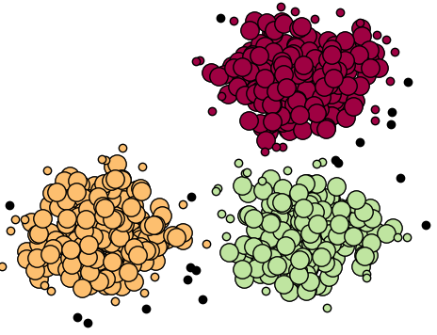
What is clustering?
Unsupervised learning
Group by similarity
Goal:
High intra-cluster similarity
Low inter-cluster similarity

Slide 6









But how do we determine similarity?
No obvious objective function
f(x) = “maximize similarity”
?????
Hot/Cold
Food/Beverage

Slide 7
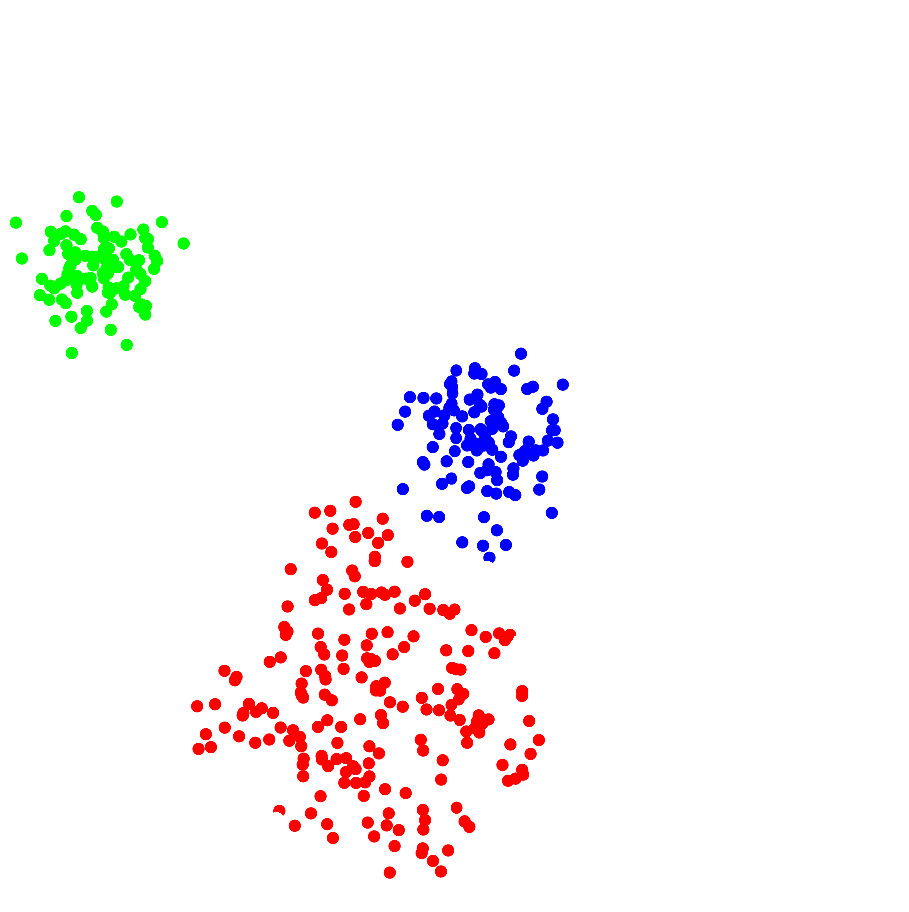
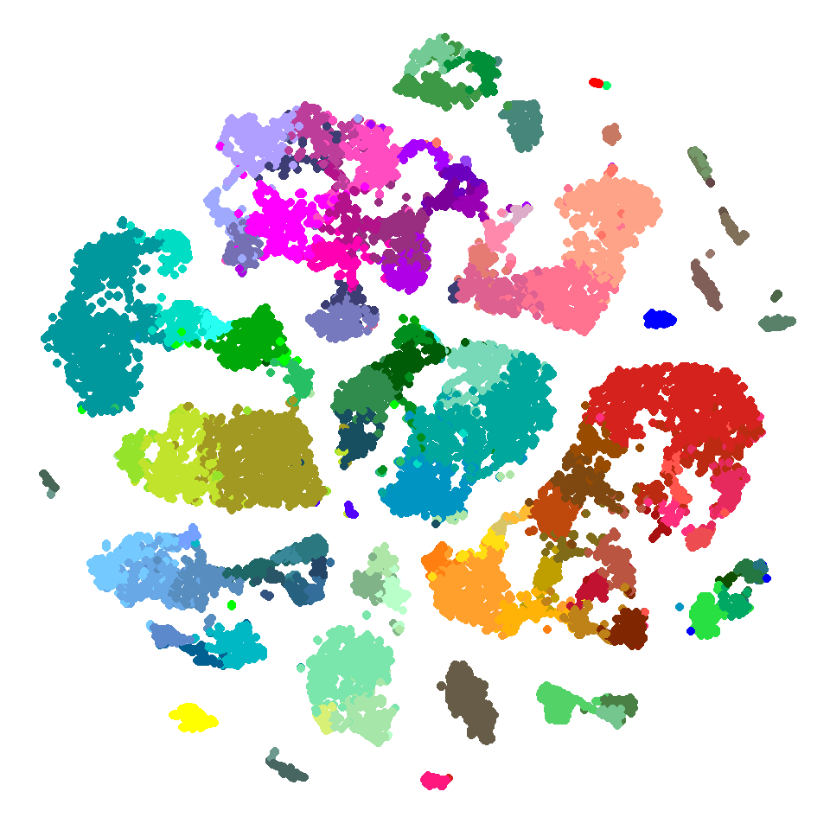
What if divisions not obvious?

Slide 8
Distance Metrics
Euclidian
Manhattan
Minkowski
Cosine Similarity
….

Slide 9

Distance Metrics
Euclidian
Manhattan
Minkowski
Cosine Similarity
….
Notes:
https://subscription.packtpub.com/book/big_data_and_business_intelligence/9781785882104/6/ch06lvl1sec40/measuring-distance-or-similarity

Slide 10




Distance Metrics
Euclidian
Manhattan
Minkowski
Cosine Similarity
….
L1
L2
Notes:
https://subscription.packtpub.com/book/big_data_and_business_intelligence/9781785882104/6/ch06lvl1sec40/measuring-distance-or-similarity

Slide 11
K-Means Clustering

Slide 12
Algorithm
1) Decide on K centers
2) Initialize K centers
3) Assign points to the nearest centers
4) Move center towards mean
5) Recompute distances
6) Reassign clusters
7) Move centers
8) Halt when no change -- Converged!
Notes:
Random initialization popular

Slide 13
Algorithm
1) Decide on K centers
2) Initialize K centers
3) Assign points to the nearest centers
4) Move center towards mean
5) Recompute distances
6) Reassign clusters
7) Move centers
8) Halt when no change -- Converged!
Notes:
Random initialization popular

Slide 14
Algorithm
1) Decide on K centers
2) Initialize K centers
3) Assign points to the nearest centers
4) Move center towards mean
5) Recompute distances
6) Reassign clusters
7) Move centers
8) Halt when no change -- Converged!
Notes:
Random initialization popular

Slide 15
Algorithm
1) Decide on K centers
2) Initialize K centers
3) Assign points to the nearest centers
4) Move center towards mean
5) Recompute distances
6) Reassign clusters
7) Move centers
8) Halt when no change -- Converged!
Notes:
Random initialization popular

Slide 16
Algorithm
1) Decide on K centers
2) Initialize K centers
3) Assign points to the nearest centers
4) Move center towards mean
5) Recompute distances
6) Reassign clusters
7) Move centers
8) Halt when no change -- Converged!
Notes:
Random initialization popular

Slide 17
k-Means Pros and Cons
1) Intuitive
2) Easy to Implement
3) Simple
4) Reasonably effective
1) Must specify K
2) Initialization important
3) Weak with noisy data
4) Searches for elliptical/spherical clusters
5) Memory costs

Slide 18
Hierarchical Clustering

Slide 19
Hierarchical
Nested clusters
Idea of membership
Intuitive, explicative, and visualizable
Dendrograms
Use Cases: Genetics, evolutionary biology, user rec.

Slide 20
Motivation: Animal Dendrogram
Slug
Ugly
Slimy
Hairy
Bumpy
Tapeworm
. . .
Animal
Scary
Grizzly
Penguin
Land
Lemus
Cute
Water

Slide 21
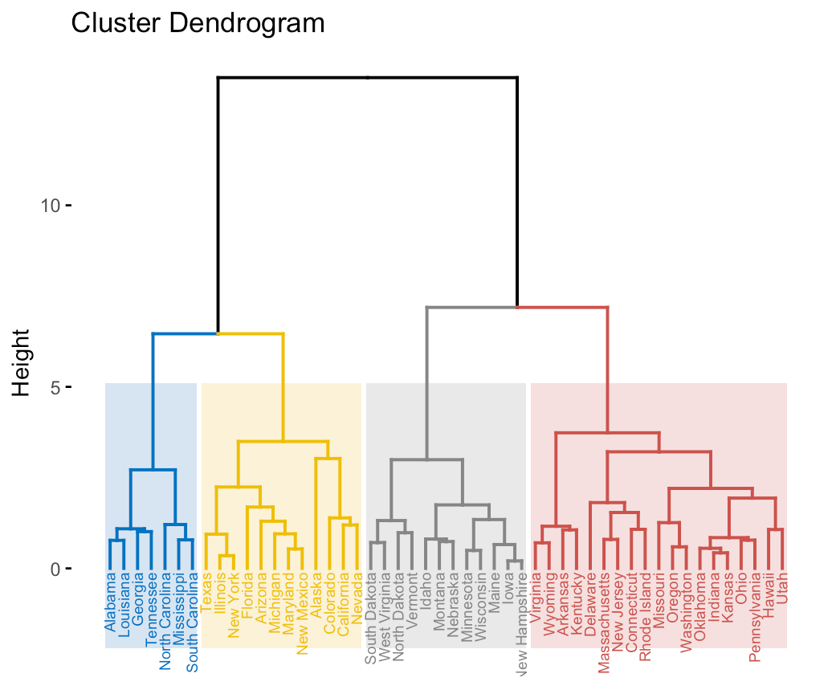
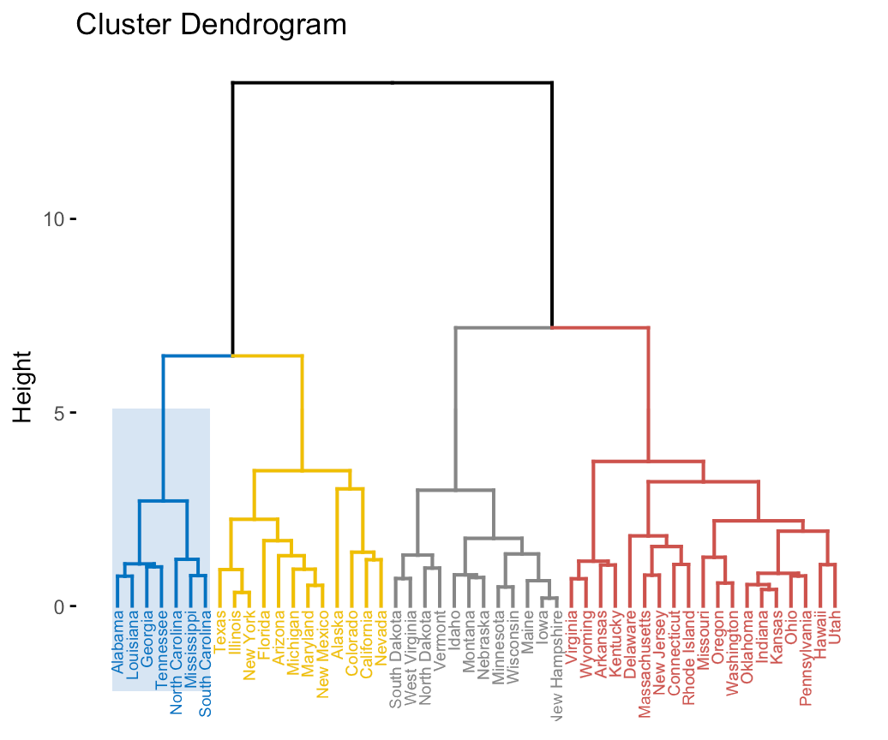
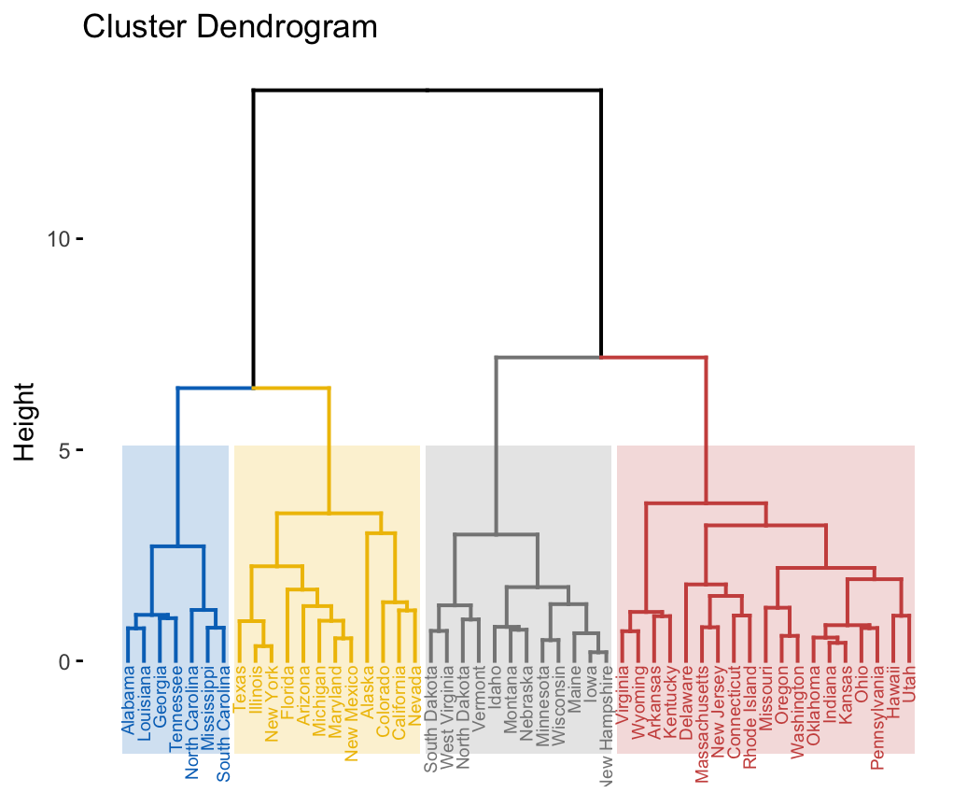
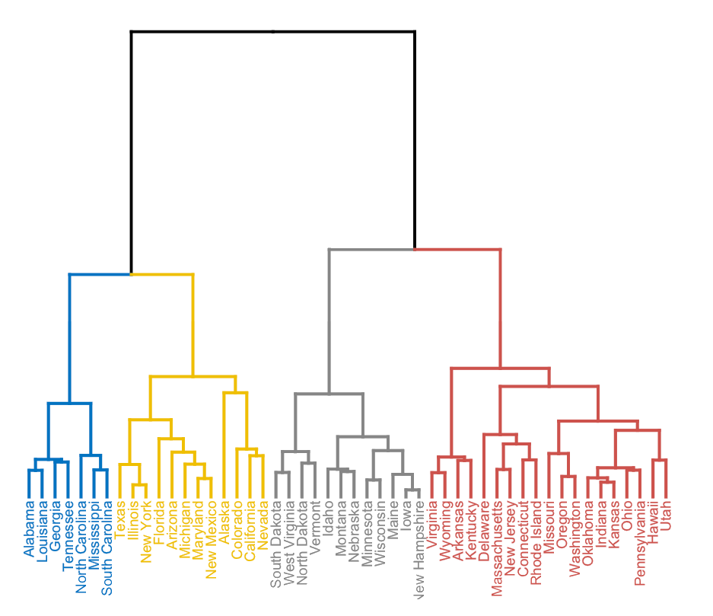
Dendrograms
Dendrogram
Indicates membership

Slide 22
Algorithm
1) Compute distances between all points/clusters
2) Place into proximity matrix
3) Find closest pair
4) Merge
5) Repeat 1-4 until only one
point/cluster exists

Slide 23
Algorithm
1) Compute distances between all points/clusters
2) Place into proximity matrix
3) Find closest pair
4) Merge
5) Repeat 1-4 until only one
point/cluster exists
A
A
A
A
A
A
A
A
A
A
A

Slide 24
Visualize: Proximity Matrix
 | A | B | CDG | E | FH | I
A | x | 134 | 12 | 85 | 74 | 32
B | 6.5 | x | 43 | 28 | 7.87 | 89
CDG | 123 | 89 | x | 2 | 32 | 73
E | 57 | 4 | 234 | x | 23 | 75
FH | 9 | 32 | 65 | 34 | x | 92
I | 46 | 221 | 523 | 82 | 6.43 | 81

Slide 25
Other Way to Visualize: “The Blob”

Slide 26
Challenges?
(complexity. speed. how to compute distances.)

Slide 27
Computing distances between clusters
Min
Max
Ward’s Method
...
Group Average
https://cs.wmich.edu/alfuqaha/summer14/cs6530/lectures/ClusteringAnalysis.pdf strencths and weaknesses
Notes:
https://towardsdatascience.com/understanding-the-concept-of-hierarchical-clustering-technique-c6e8243758ec

Slide 28
Computing distances between clusters
Min
Max
Ward’s Method
...
Group Average
Sim(C1,C2) =
Max Sim(Pi,Pj)
Sim(C1,C2) =
Min Sim(Pi,Pj)
Sim(C1,C2) =
∑ (dist(Pi, Pj))²/|C1|*|C2|
https://cs.wmich.edu/alfuqaha/summer14/cs6530/lectures/ClusteringAnalysis.pdf strencths and weaknesses
Notes:
https://towardsdatascience.com/understanding-the-concept-of-hierarchical-clustering-technique-c6e8243758ec

Slide 29
Hierarchical Pros and Cons
1) User understands the data
2) Reveals more info/hidden trends
3) Idea of “membership”
3) Don't need to specify # of clusters
4) Adjustable to improve accuracy
(ex distance measures)
5) Can handle non-spherical clusters
1) Complexity
On^2 space
On^3 time
2) Scalability
3) Handling noise
4) Settling on cluster distance computation
5) O(N^2logn) complexity

Slide 30
Density-Based Clustering

Slide 31
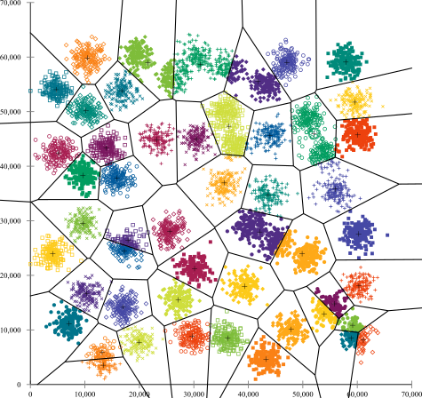
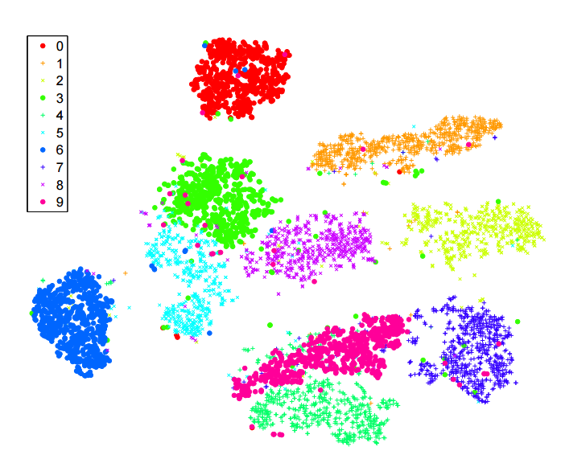
Motivation
Not all data is this “easy”
What is “simple” about this data?

Slide 32
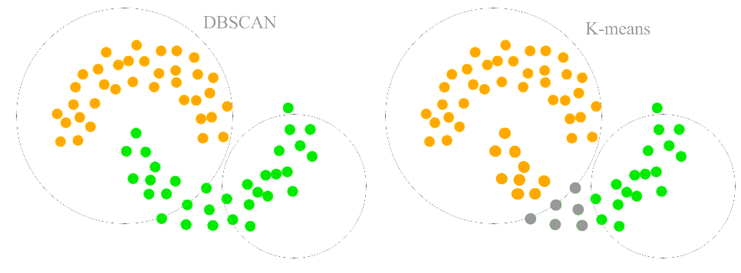
Handling Non-Elliptical Clusters

Slide 33
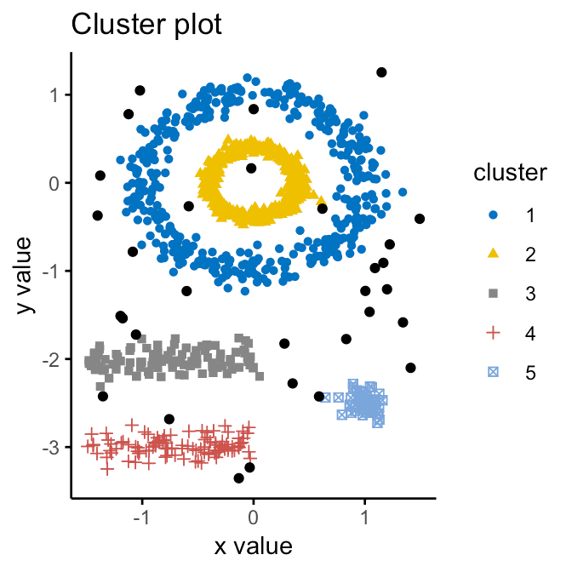
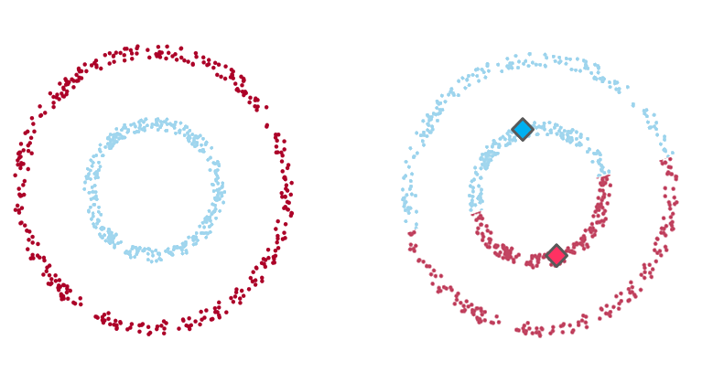
Non-Elliptical Continued

Slide 34
DBSCAN: Key Terms
Idea
Epsilon field
Like radius
Three types of points
Core
Border
Reachable
Noise/Outlier
E
Core
Notes:
https://towardsdatascience.com/understanding-the-concept-of-hierarchical-clustering-technique-c6e8243758ec

Slide 35
DBSCAN: Key Terms
Idea
Epsilon field
Like radius
Three types of points
Core
Border
Reachable
Noise/Outlier
Noise
Core
Notes:
https://towardsdatascience.com/understanding-the-concept-of-hierarchical-clustering-technique-c6e8243758ec

Slide 36
DBSCAN: Key Terms
Idea
Epsilon field
Like radius
Three types of points
Core
Border
Reachable
Noise
Noise
Core
Border
Notes:
https://towardsdatascience.com/understanding-the-concept-of-hierarchical-clustering-technique-c6e8243758ec

Slide 37
DBSCAN Algorithm
Given e and min_num
Classify points
Core point if:
min_num points are within e
Border if:
if within epsilon of a core point
Outlier if:
Not reachable by core
2) Group Core Points into one cluster
Notes:
https://www.coursera.org/lecture/machine-learning-with-python/dbscan-B8ctK

Slide 38
DBSCAN Algorithm
Given e and min_num
Classify points
Core point if:
min_num points are within e
Border if:
if within epsilon of a core point
Outlier if:
Not reachable by core
2) Group Core Points into one cluster
Notes:
https://www.coursera.org/lecture/machine-learning-with-python/dbscan-B8ctK

Slide 39
DBSCAN Algorithm
Given e and min_num
Classify points
Core point if:
min_num points are within e
Border if:
if within epsilon of a core point
Outlier if:
Not reachable by core
2) Group Core Points into one cluster
Notes:
https://www.coursera.org/lecture/machine-learning-with-python/dbscan-B8ctK

Slide 40
DBSCAN Algorithm
Given e and min_num
Classify points
Core point if:
min_num points are within e
Border if:
if within epsilon of a core point
Outlier if:
Not reachable by core
2) Group Core Points into one cluster
Notes:
https://www.coursera.org/lecture/machine-learning-with-python/dbscan-B8ctK

Slide 41
DBSCAN Algorithm
Given e and min_num
Classify points
Core point if:
min_num points are within e
Border if:
if within epsilon of a core point
Outlier if:
Not reachable by core
2) Group Core Points into one cluster
Notes:
https://www.coursera.org/lecture/machine-learning-with-python/dbscan-B8ctK

Slide 42
DBSCAN Algorithm
Given e and min_num
Classify points
Core point if:
min_num points are within e
Border if:
if within epsilon of a core point
Outlier if:
Not reachable by core
2) Group Core Points into one cluster
Notes:
https://www.coursera.org/lecture/machine-learning-with-python/dbscan-B8ctK

Slide 43
DBSCAN Algorithm
Given e and min_num
Classify points
Core point if:
min_num points are within e
Border if:
if within epsilon of a core point
Outlier if:
Not reachable by core
2) Group Core Points into one cluster
Notes:
https://www.coursera.org/lecture/machine-learning-with-python/dbscan-B8ctK

Slide 44
DBSCAN Pros and Cons
1) Arbitrarily-shaped clusters
2) Non-linearly separable clusters
2) Don't need to specify cluster count
3) Robust to noise
1) Considers low density as outliers
2) Scalability
Harms Euclidean distance measures
3) Assumes constant density

Slide 45
Questions?

